Slide 1
WORLD OF DRONE
Design: Manned Aircraft vs UAV

Slide 2
Design: Manned Aircraft vs UAV
Manned and unmanned aircraft of the same type generally have recognizably similar physical components.
The main exceptions are the cockpit and environmental control system or life support systems.

Slide 3
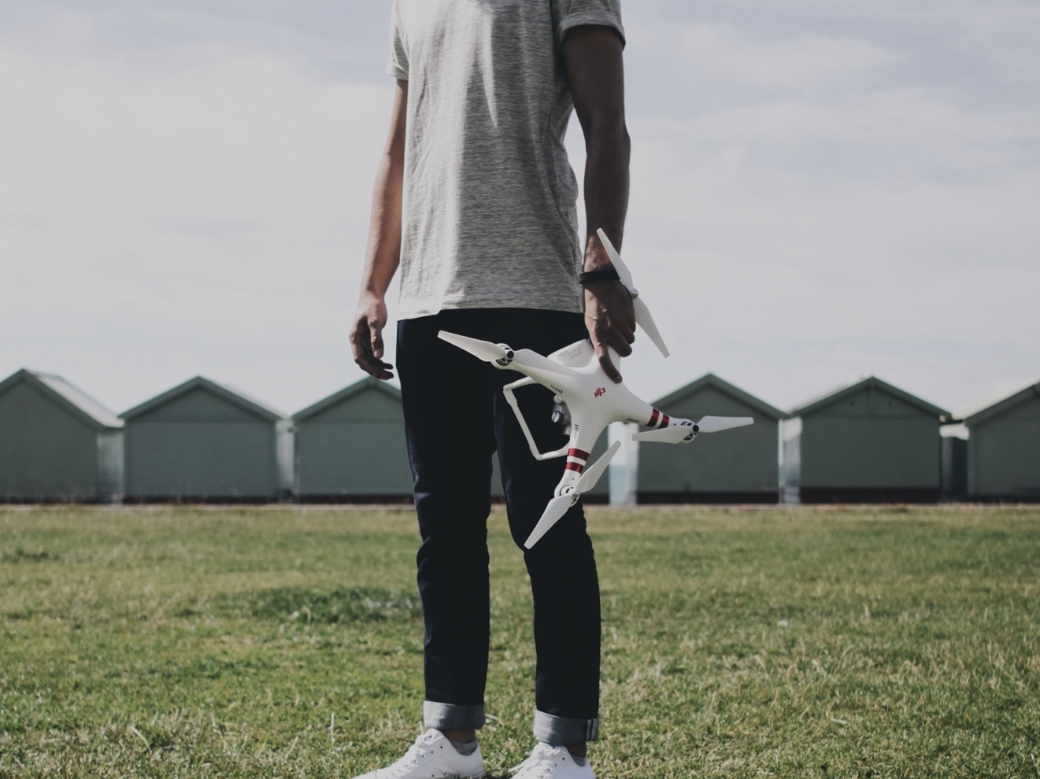
Design: Manned Aircraft
vs UAV
Some UAVs carry payloads (such as a camera) that weigh considerably less than an adult human, and as a result can be considerably smaller.

Slide 4
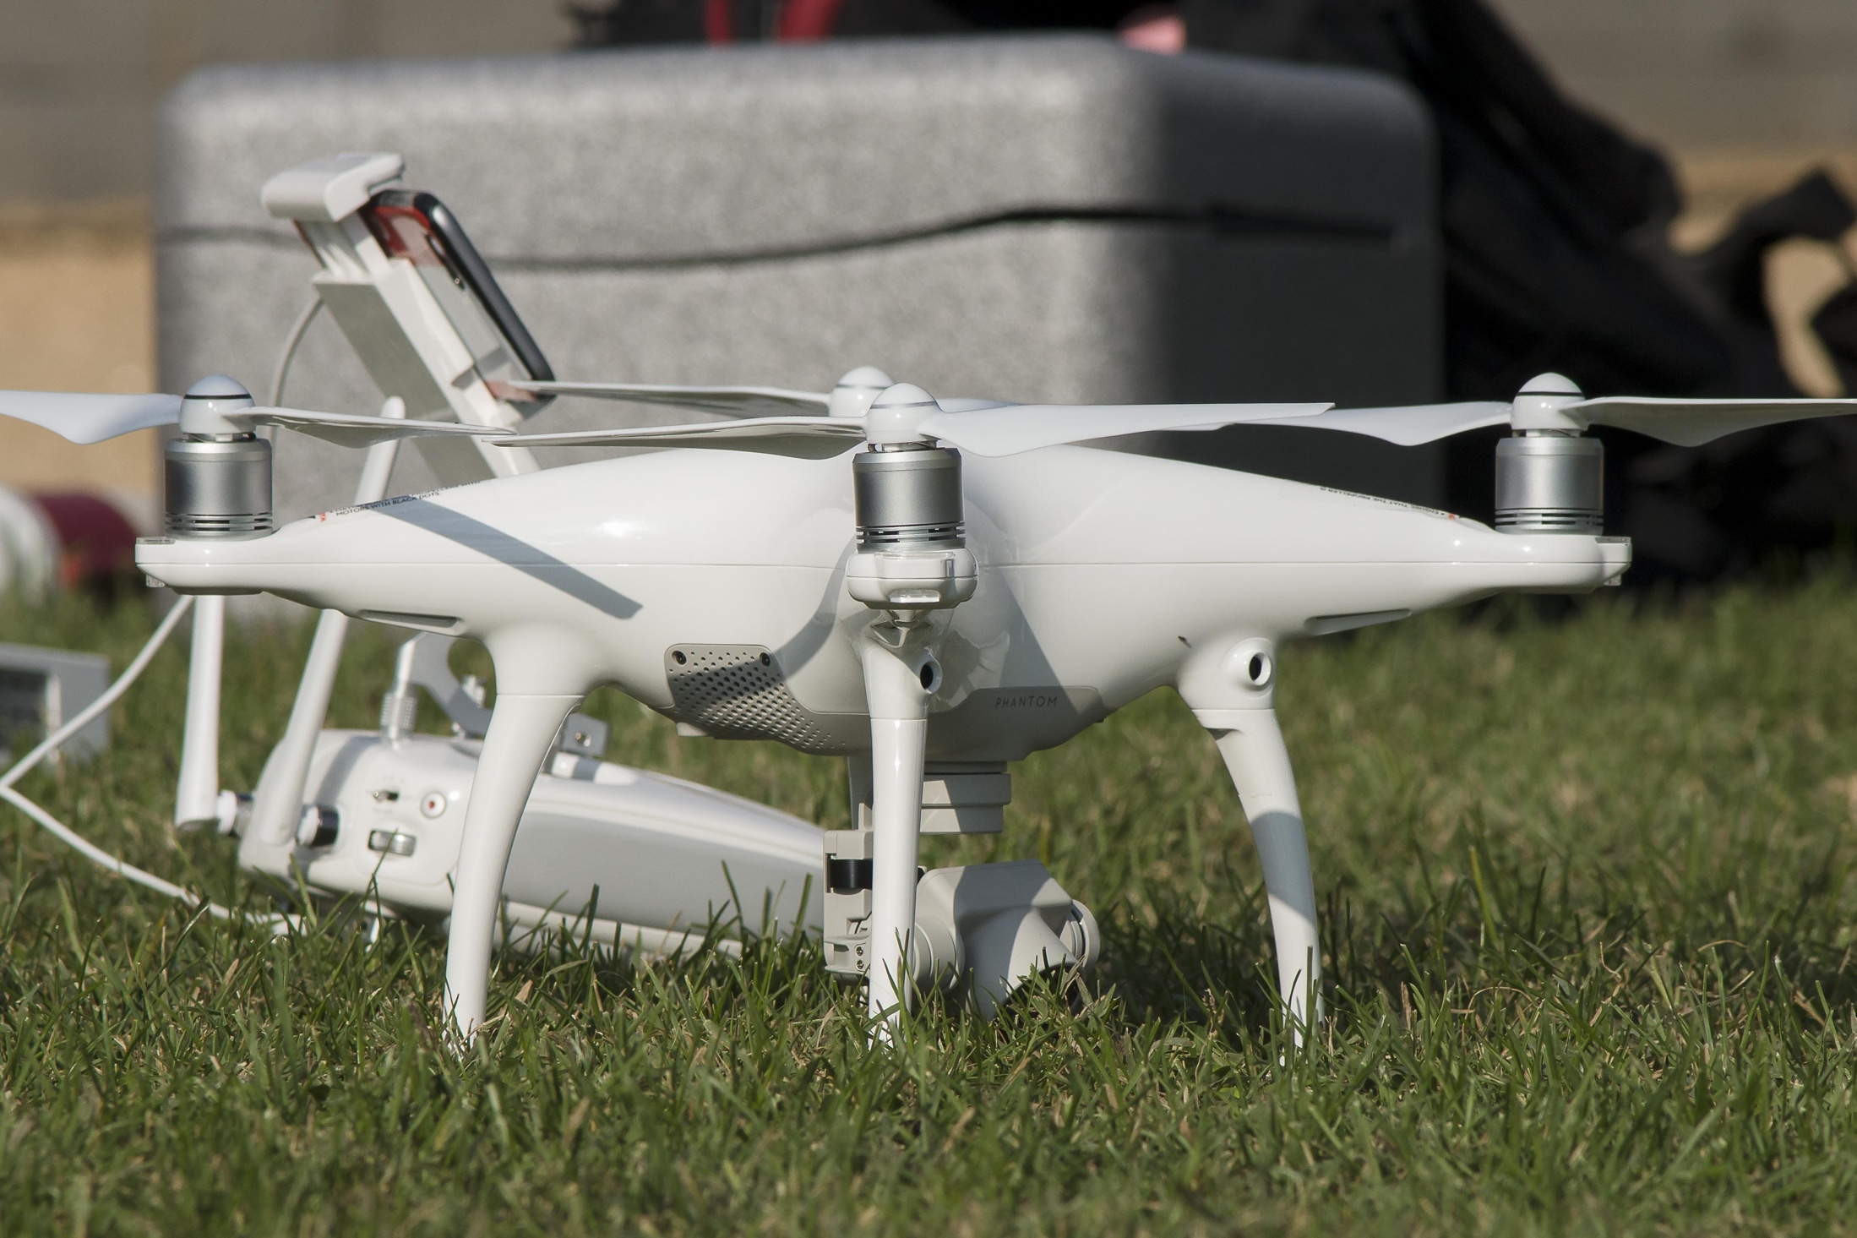
Design: Manned Aircraft vs UAV
Small civilian UAVs have no life-critical systems, and can thus be built out of lighter but less sturdy materials and shapes, and can use less robustly tested electronic control systems.

Slide 5
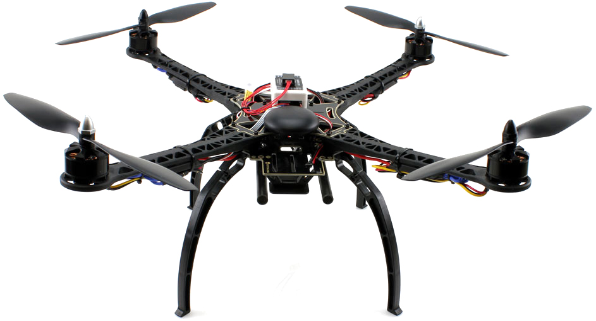
Design: Manned Aircraft vs UAV
For small UAVs, the quadcopter design has become popular, though this layout is rarely used for manned aircraft.

Slide 6
Design: Manned Aircraft vs UAV
For remote human control, a camera and video link almost always replace the cockpit windows

Slide 7
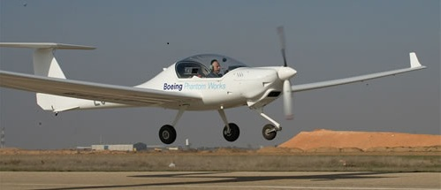
Design: Manned Aircraft vs UAV
Radio-transmitted digital commands replace physical cockpit controls. Autopilot software is used on both manned and unmanned aircraft, with varying feature sets.

Slide 8
?
WELL DONE!
Now you can move on to the next topic...
Drone Components: Body and Power Supply!

